Slide 1
Online Edu. Employment (Android)
Design Workshop
VEL team
21 Aug. 2015

Slide 2
Project Plan
Agenda
1. xxx
2. xxx
3. xxx
4. xxx
5. xxx
6. Admin Module
7. xxx
8. xxx

Slide 3
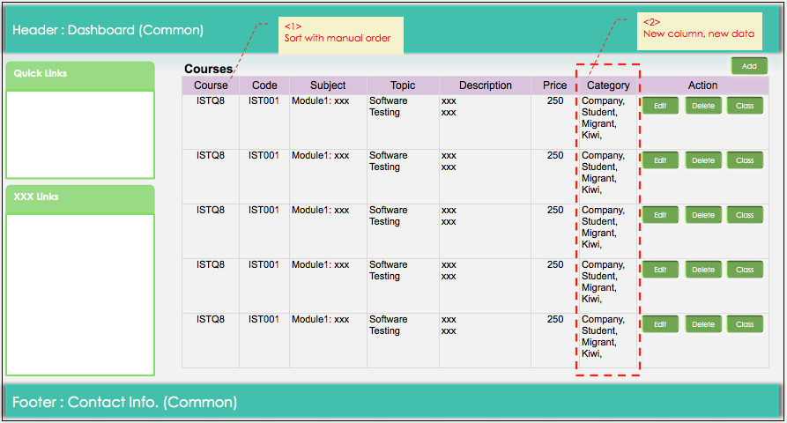
6. Admin Module (1)
Admin Module: Courses

Slide 4
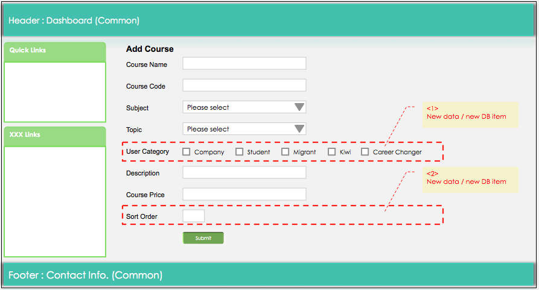
6. Admin Module (2)
Admin Module: Courses

Slide 5
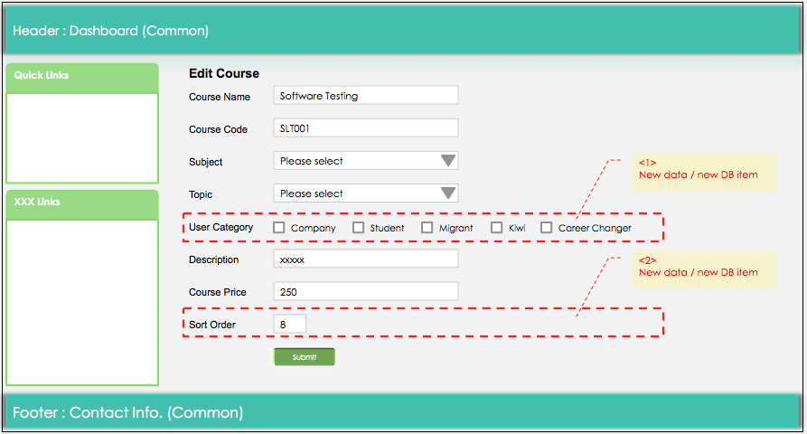
6. Admin Module (3)
Admin Module: Courses

Slide 6
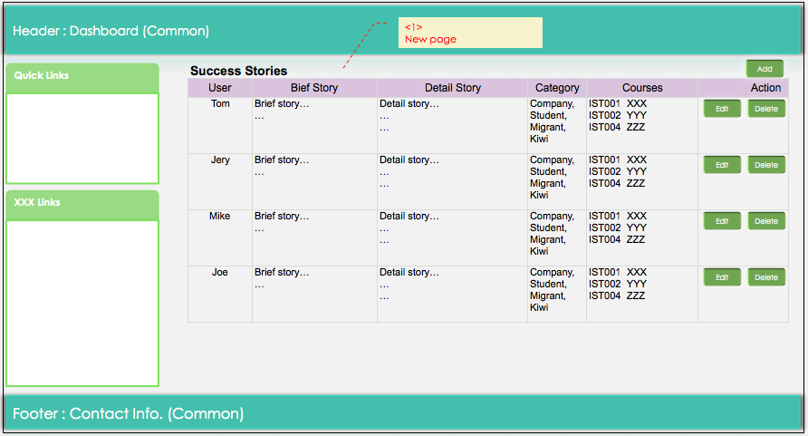
6. Admin Module (4)
Admin Module: Success Stories

Slide 7
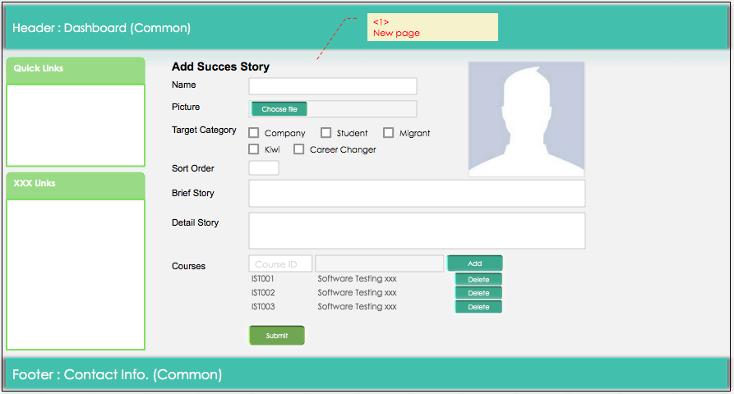
6. Admin Module (5)
Admin Module: Success Stories

Slide 8
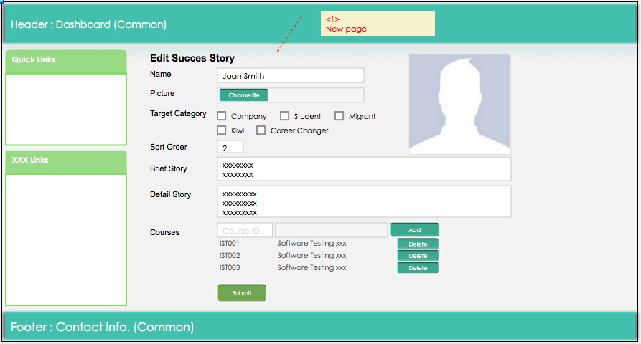
6. Admin Module (6)
Admin Module: Success Stories

